Slide 1
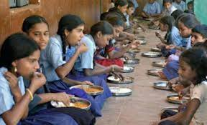
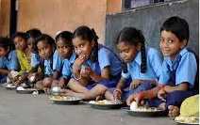
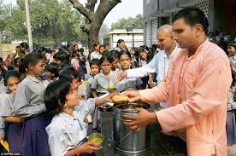
Mid Day Meal Scheme
Annual Work Plan & Budget – 2018-19
Department of School Education
Government of Andhra Pradesh

Slide 2
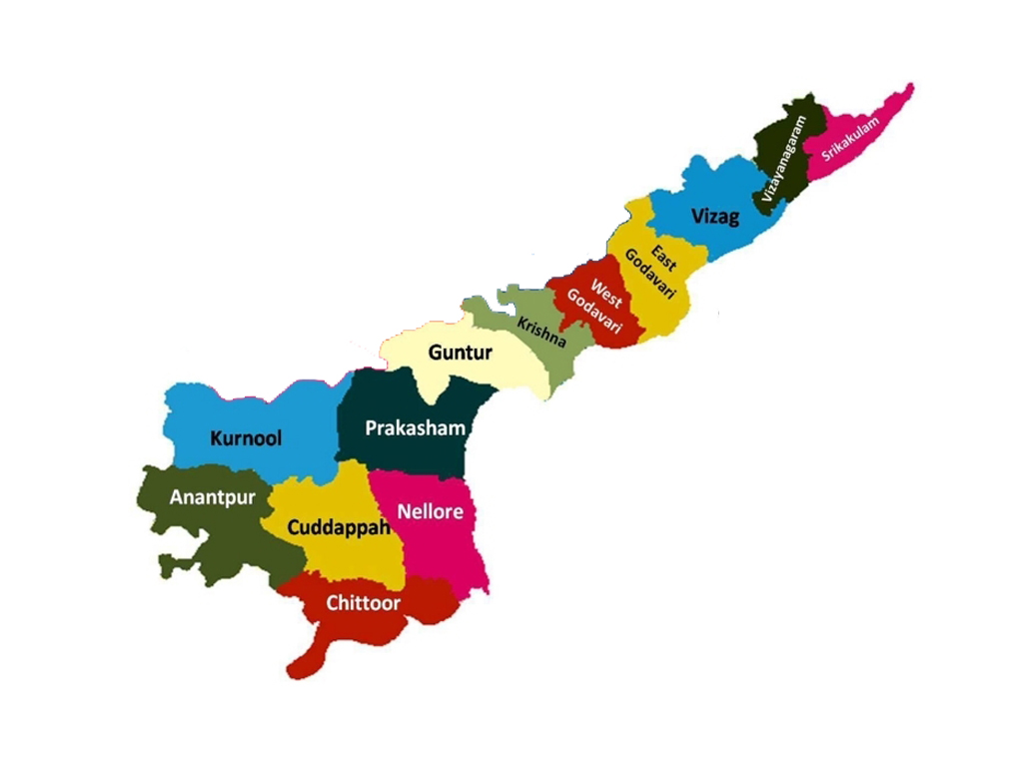
DEMOGRAPHY
ANDHRA PRADESH
 | No. of Districts | 13
 | No. of Mandals | 670
 | No. Of Revenue Divisions | 51
 | No. Of Municipalities | 97
 | No. Of corporations | 13
 | No. of Habitations | 47,861
 | Population | 4,95,77,103
 | Child Population (6-15) | 84,67,577
 | Agency districts | Srklm, Vznrm,VSP, EG & W.Godavari.
School Education, Govt. of Andhra Pradesh

Slide 3
Coverage during 2017-18
Sl.No | Type of Schools | Approved by PAB |  | Achievement (31.04.2017)
 |  | Schools | Children | Schools | Children
1. | Primary (I to V) | 34653 | 1740000 | 34812 | 1656414
 | STC (NCLP) | 64 | 2472 | 64 | 3837
2 | Upper Primary (VI to VIII) | 10957 | 1004000 | 10629 | 963760
GRAND TOTAL |  | 45674 | 2746472 | 45505 | 2624011
3 | CCHs now working |  | 88296
4 | Working Days |  | 220
5 | Working Days for NCLP |  | 302
3
School Education, Govt. of Andhra Pradesh

Slide 4
Cooking Cost (per day / per Child) in Rs:
Category | Cooking Cost before 31.07.2017 |  |  | Cooking Cost 01.8.2017 (60:40)
 | Central | State* | Total | Central | State* | Total
Primary | 2.48 | 2.65 | 5.13 | 2.48 | 4.00 | 6.48
UPS | 3.71 | 3.47 | 7.18 | 3.71 | 4.82 | 8.53
Note: State Government is providing Rs.2.35 per child per day towards cost of egg. From the year 2018-19 it is proposed to provide 5 eggs.
4
School Education, Govt. of Andhra Pradesh

Slide 5
Coverage -1-4th Qtrs (2017-18)
In Lakhs

Slide 6
Budget Releases Vs Expenditure 2017-18
Component | Releases |  |  | Expenditure |  |  | % of expdtr
 | Central | State | TOTAL | Central | State | TOTAL
Foodgrains | 1868.13 | -- | 1868.13 | 1308.55 | -- | 1308.55 | 70.05
Transportation | 462.41 | -- | 462.41 | 462.41 | -- | 462.41 | 100
Cooking Cost | 17291.39 | 25408.41 | 42699.80 | 16946.56 | 22815.30 | 39761.86 | 93.12
Honorarium to CCHs | 5737.02 | 3824.68 | 9561.70 | 5297.76 | 3531.84 | 8829.60 | 92.34
MME | 354.88 | -- | 354.88 | 271.01 | -- | 271.01 | 76.36*
TOTAL | 25713.83 | 29233.09 | 54946.9 | 24286.29 | 26347.1 | 50633.43 | 92.15
* Orders for purchase of eating plates to the tune of approximately 5.00 Crs. But due to lack of budget the payment could not be made.

Slide 7
Release of Food Grains & Payment to FCI
In MTs
(In MTs)
Items | Primary | Upper Primary | Total
Allocation I & IV Qtrs | 38280.000 | 33243.990 | 71523.990
Lifted (up to March 2018) | 34578.420 | 27076.471 | 61654.891
Bills raised by FCI |  | Payment to FCI
Qty (in MTs) | Amount in lakhs | Qty (in MTs) | Amount in Lakhs
61654.891 | 1868.14 | 45930.976 | 1391.71
Note: Owing to release of budget at the end of March a few bills cannot be cleared.
School Education, Govt. of Andhra Pradesh

Slide 8
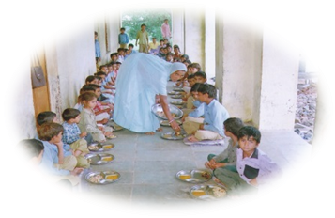
Cook-cum-Helpers
92,105 Cook cum Helpers approved by PAB and the same engaged by State.
The number of cook cum helpers now working came to 88296 in view of centralisation of payment and Coverage of more number of schools by NGOs.
All CCHs are having bank account and receiving honorarium through Bank Account.
The CCHs are engaged as follows:
One Cook-cum-Helper – for Schools having up to 25 students
Two Cook-cum-Helpers - for Schools having 26 to 100 students
One additional Cook-cum-Helper - for every addition of 100 students.
School Education, Govt. of Andhra Pradesh

Slide 9
Involvement of NGOs / Trusts
6 NGOs/ Trusts are already engaged covering 212964 children in 1794 schools in 8 districts for serving of MDM through centralized kitchen.
Maximum 20 km distance and 1 hr time taken for delivery of food from centralized kitchen
Measures taken to ensure delivery of hot cooked meals to schools
Responsibility of receiving cooked meals at the schools from the centralized kitchens by the HM / Teacher and hot cooked meal served by the CCH.
Food supply containers are sealed at the time of supply of meals to schools.

Slide 10
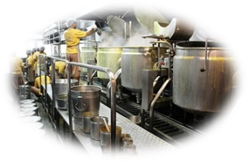
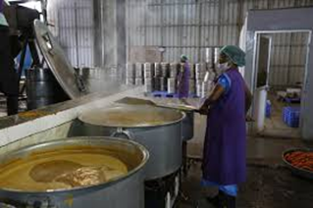
EXISTING CENTREALISED KITCHENS
Number of NGOs | Districts covered | Mandals covered | Schools covered | children covered
6 | 8 | 48 | 1794 | 212964
PROPOSED CLUSTER KITCHENS 2018-19
Number of Firms/ Organizations | Districts covered | Mandals covered | Clusters | Schools covered | children covered
3 | 13 | 291 | 71 | 19794 | 1541172
Notes:
n

Slide 11
AMS Reported Schools Percentage
State average % :: 85.90

Slide 12
Quality Safety and Hygiene
All Schools are having hand- washing facility
Types of facility of Hand washing
Multi-tap, - 10106
Tap, - 14627
hand pump, - 13405
The RO / filtered water is supplied in 3053 schools by the donors like old Students associations/Reputed companies.
The Head Master, Head Cook are shouldering the responsibility of Midday meals at school level and Mother’s Committee also has been constituted in schools.
Mothers of the students are tasting the cooked food every day and their opinions also been recorded in Tasty registers.
The cooked food is tasted by HM/ teachers of the institution before serving it to the children.
School Education, Govt. of Andhra Pradesh

Slide 13
SCHOOL HEALTH PROGRAMME (RBSK)
The number of institutes and Children covered under RBSK
Health Checkups done under RBSK
Weekly Iron & Folic Acid Supplementation (WIPS)
Deworming Medicine distributed.
Spectacles distributed.
Stage | Health Check up |  | Distribution of Iron Folic Acid |  | De-worming |  | Spectacles
 | Centers | Children | Centers | Children | Centers | Children | Centers | Children
Primary & Upper Priy | 45505 | 2707096 | 42553 | 2191310 | 45265 | 2581476 | 14849 | 120681
School Education, Govt. of Andhra Pradesh

Slide 14
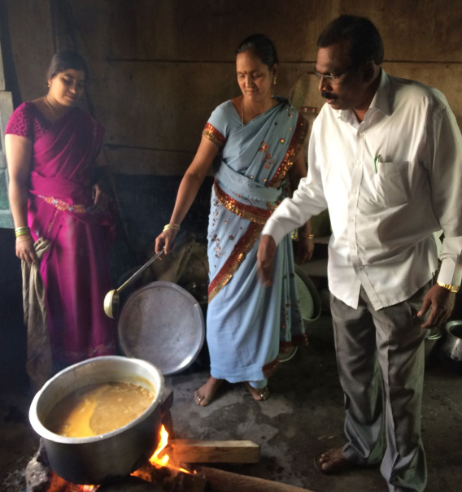
Mode of Cooking
98.45%
1.55%
Mode of Cooking MDM in schools
Gas Connections: Approximately 98.45% of schools are provided LPG connections. It is also proposed to provide LPG stove to all the schools during the year 2018-19.
School Education, Govt. of Andhra Pradesh

Slide 15
Construction of Kitchen Sheds
Phase | Units Sanction | Budget Provision in Cr. | Releases in Cr. | Completed | Progress | To be started | Expenditure in Crores
I | 31213 | 187.28 | 169.81 | 11690 | 19523 units surrender to Govt. |  | 70.14
II | 13103 | 196.54 | 164.03 | 5760 | 1874 | 5469 | 8203.50
TOTAL | 44316 | 383.82 | 333.84 | 17450 | 1874 | 5469 | 8273.64
15

Slide 16
Initiatives of the State
MDM extended to IX to X children: IX to X children are brought under MDM programme with 100% State share
Supply of edible Oil and Dal to School points: It is proposed to supply Refined Oil/ Palmolive Oil and Dal to school point through AP Oil Fed or by centralised tender from the academic year 2018-19.
Regular Effective Monitoring on MDM: Regular monitoring by the State officials through video conferences basing on fortnightly visit reports of the DEOs and regular visits of the state level officers.
E-Monitoring: Website for affective Online Monitoring of MDM was launched. Entry of MDM data through online is effectively working in the State.
Aadhar Linkage: To have accurate enrolment data the Aadhar Seeded Child info data, UDISE data & Mid Day Meal data is being integrated.

Slide 17
e-pos system: the e-pos system has been introduced in MDM during 2016-17. schools (UDISE Code) are mapped with the nearby fair price shops. Bio-metric system is developed by the Civil Supply system. The school HM/SHG to lift the food-grains with Aadhar authentication. The is linked with CM’s dash board, which is developed for monitoring of every scheme every day.
Centralisation of payment: The Centralized payment system has been introduced from August 2017. A website is developed with the assistance APCFSS. The bank details of SHGs/NGOs are captured through the website and mapped to the School UDISE. The payment will be made before 15th of the succeeding month.
Social Audit: The social audit has been done in all the districts. Society for Social Audit, Accountability & Transparency (SSAAT) a NGO have conducted social audit. Total Expenditure of the programme is Rs.19.80 lakhs.
Supply of eating plates: It is proposed to supply lunch plates to all the children under MDM Scheme. In the first instant plates is being supplied in the Drought affected districts.

Slide 18
MIS-Online Data Entry Status 2017-18

Slide 19
Best Practices in MDM
State Government provided MDM to the 718547 children of IX & X with budget provision of Rs.21915.21 Lakhs.
All the CCHs in the State have been trained for preparation of hygiene, safe and quality food under MDM.
12747 Schools are identified for planting Kitchen gardens for the purpose of MDM. Out of this 3181 schools already planted kitchen gardens. It is under progress in 8415 schools.
School Education, Govt. of Andhra Pradesh

Slide 20
ISSUES on MDM
Enhancement of Transportation Rs.750 to 1000/-(per Mts)
Enhancement of Honorarium to CCHs Rs.1000/- to Rs.4000 /-
Kitchen Sheds re-allotment & enhanced unit cost for the surrendered 19523 units.
We need separate fund for establishment of Cluster Centralized Kitchens cum stores.
Remuneration to MIS Co-ordinators at Mandal level Rs.1000/- pm for MDM MIS online data entry.
School Education, Govt. of Andhra Pradesh

Slide 21
Requirement of Budget for 2018-19
Rs in Lakhs
Component | Primary |  |  |  | Upper Primary |  | NCLP |  | TOTAL
 | Central |  |  | State | Central | State | Central | State
Food-grains | 1196.69 | 0.00 | 1130.47 | 0.00 | 5.4 | 0.00 | 2332.48 | 0.00 | 2332.59
Cooking Cost | 9794.73 | 15797.94 | 9227.76 | 11988.64 | 44.31 | 57.57 | 19066.80 | 27844.14 | 46910.95
Transport Charges | 296.21 | 0.00 | 279.82 | 0.00 | 1.34 | 0.00 | 577.37 | 0.00 | 577.37
MME | 442.67 | 0.00 | 374.03 | 0.00 | 1.54 | 0.00 | 818.24 | 0.00 | 818.24
Honorarium to CCHs | 3468.42 | 2312.28 | 1829.34 | 1219.56 | 0.00 | 0.00 | 5780.70 | 3048.90 | 8829.60
Total | 15021.57 | 18110.22 | 12470.8 | 13063.48 | 51.98 | 57.57 | 28197.37 | 30893.04 | 59468.75
21
Notes:
21
21

Slide 22
Proposals drought affected areas - 2018-19
Rs in Lakhs
Component | Primary |  | Upper Primary |  | TOTAL |  | Grand Total
 | Central | State | Central | State | Central | State
Food-grains | 30.88 | 0.00 | 25.06 | 0.00 | 55.94 | 0.00 | 55.94
Cooking Cost | 252.77 | 407.69 | 204.52 | 265.72 | 457.29 | 673.41 | 1130.70
Transport | 7.64 | 0.00 | 6.20 | 0.00 | 13.84 | 0.00 | 13.84
MME | 10.35 | 0.00 | 7.72 | 0.00 | 18.07 | 0.00 | 18.07
Honorarium to CCHs | 47.15 | 31.43 | 18.06 | 12.04 | 65.21 | 43.47 | 108.68
Total | 348.79 | 439.12 | 261.56 | 277.76 | 610.35 | 716.88 | 1327.23
Enrolment of draught effected area : Primary-242673, UP-272143, CFHs-10867

Slide 23
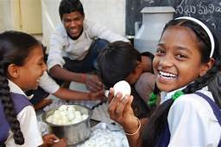
State level Supply of Eggs to the Schools
Objectives:
To Provide Eggs thrice a week per child.
To provide additional Nutritious food to the students.
To maintain uniformity in providing food in all schools.
Process:
3 eggs per week are being supplied to all the children from August 2017.
It is proposed to provide 5 eggs per week per child from the academic year 2018-19.
The Eggs weighing 45 to 52 grms are supplied.
Eggs are supplied to the school point once in a week.
To avoid supply of time barred Eggs, the Color stamp assign on the Eggs.

